Slide 1
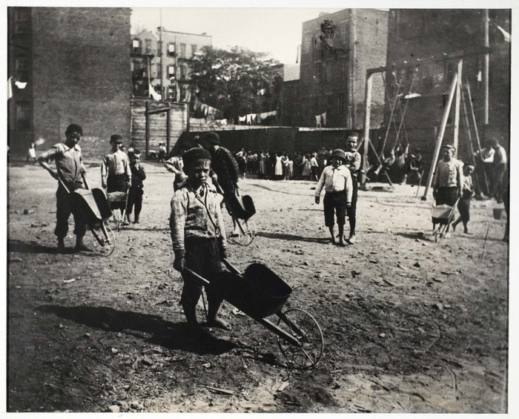
Mapping Inequality POVERTY Gap Analysis Across Regions

Slide 2
Sub-Saharan Africa: Persistent High Poverty Gap This region faced the highest poverty gap, peaking in the early 1990s, followed by a gradual decline with fluctuations. Economic stagnation, political instability health crisis like HIV/AIDS worsened poverty
South Asia: Steady Decline in Poverty Gap: The poverty gap in South Asia peaked in the late 1980s but has shown a consistent decline, particularly since the early 2000s. Economic liberalization, agricultural productivity improvements during the Green Revolution reduced rural poverty
East Asia & Pacific: Remarkable Decline in Poverty Gap:There is a consistent decrease in poverty gap from the mid-1980s, with a sharp decline post-1990. Economic reforms, drove down the poverty gap, reflecting rapid industrialization.
4. Latin America & Caribbean: Stable and Low Poverty : Relatively low poverty gap, with slight fluctuations across the period. Some social policies like conditional cash transfers in Brazil and Mexico Economic stability contributed to low poverty levels helped to maintain low poverty level over the year.

Slide 3
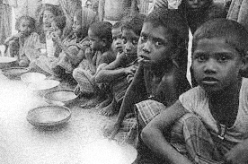
Europe & Central Asia: Minimal Poverty Gap:Low poverty gap initially, rising around the early 1990s due to post-Soviet transition, then gradually decreasing. Economic restructuring and market adaptation helped reduce the poverty gap after the 1990s.
Middle East & North Africa: Low and Stable Poverty Gap: Generally low poverty gap with some fluctuations, especially in conflict-prone years.Oil revenues funded infrastructure, education, and healthcare, reducing extreme poverty in oil-exporting countries. Political instability and conflicts in countries like Iraq and Syria caused occasional spikes.
High-Income Countries: Negligible Poverty Gap: The poverty gap in high-income countries is effectively negligible. Strong economies, advanced labor markets, and robust social safety nets ensured that extreme poverty was virtually eliminated. Investments in healthcare, education, and unemployment benefits provided a cushion for vulnerable populations.

Slide 4
East Asia & Pacific and South Asia have steadily decreased their poverty gaps since the 1990s due to economic growth and reforms.
Sub-Saharan Africa has the highest, most fluctuating gap, with peaks in the early 1990s due to structural and political challenges.
Latin America & Caribbean and Middle East & North Africa maintain low gaps with minor fluctuations.
Middle East experiences occasional conflict-related spikes. High-income countries remain stable with consistently low poverty gaps

Slide 5


Tracking global INCOME INEQUALITY
A decade-wise exploration across income groups
(1980–2019)

Slide 6
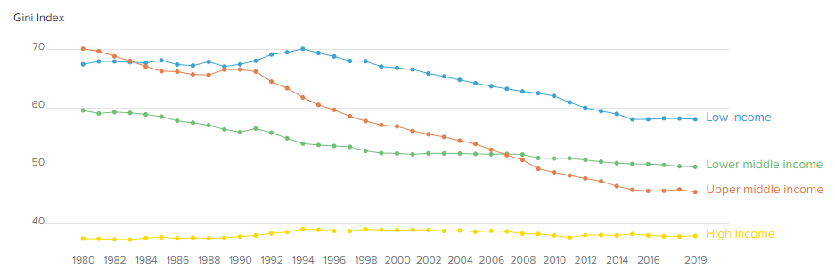
Income Inequality in Low-Income Countries: Trends and Challenges
The Gini Index is the highest among the four groups, with values around 70 in the early 1980s.There is an increase from 1980 to around 1994, after which the Gini Index gradually declines.
1980s(High Gini Index due to debt crises)
Gini Index values around 70 were recorded, reflecting increased income inequality driven by debt crises and structural adjustment programs.
1990s(Implementation of poverty reduction programs)
The introduction of pro-poor policies and international aid led to the gradual reduction of income inequality in low-income countries
By 2019(Ongoing high inequality despite improvements)
Inequality continues to be a challenge with significant urban-rural income gaps persisting in low-income countries.
MDGs were established to focus on reducing poverty, improving health, and enhancing education in low-income countries.
Initiatives prioritizing poverty reduction

Slide 7
Income Inequality in Lower Middle Income Countries
A slow but steady journey toward equality: How industrialization, globalization, and pro-poor policies shaped income distribution
1980s
1990s
2000s
By 2019
Economies remained agriculture-dependent with limited industrialization.
Structural adjustment programs had minimal impact due to weak economic diversification.
Initial shifts toward industrialization reduced rural-urban income gaps.
Governments began investing in basic healthcare and education.
Globalization spurred growth in manufacturing and services, creating new job opportunities.
Pro-poor policies like microfinance and rural development initiatives gained traction.
Diversification into manufacturing and services.
Social safety nets and targeted cash transfer programs helped lower income disparities.

Slide 8
Income Inequality in Upper Middle Income Countries
Transforming inequality: Export-led growth and social programs turned the tide in upper-middle-income countries.
1980s
1990s
2000s
by 2019
Import substitution policies concentrated wealth among urban elites.
Debt crises in Latin America and inflation hurt low-income households disproportionately.
Shift toward export-oriented growth in Asia (e.g., South Korea, Taiwan).
Stabilization of economies in Latin America led to slow improvements in income distribution.
Social welfare programs (e.g., Bolsa Família in Brazil, rural health insurance in China).
Economic growth created jobs and lifted millions out of poverty, especially in China and Brazil.
Commodity booms funded social spending.
Sustained welfare policies and a growing middle class.
Investments in education and healthcare improved long-term income distribution.

Slide 9
Income Inequality in High-Income Countries
Stable and low inequality levels maintained by robust welfare systems and progressive taxation in high-income countries
1980s
1990s
2000s
By 2019
Market deregulation and tax cuts in countries like the U.S. and U.K. increased wealth concentration.
Social welfare programs in Europe and parts of Asia mitigated inequality.
Economic stability maintained low levels of inequality.
Strengthened social protection programs and progressive taxation.
Investments in education and healthcare upheld income stability.
Ongoing economic stability and robust welfare systems.
Automation and wage stagnation caused minor increases in inequality in some countries (e.g., U.S.).

Slide 10
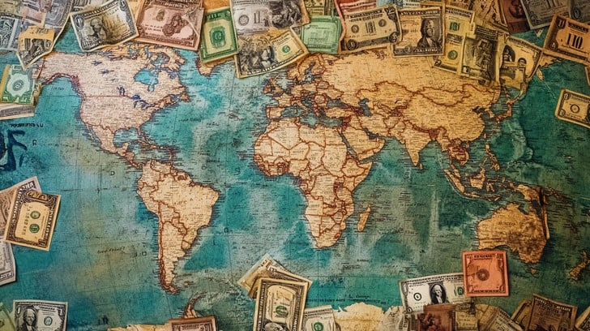
Understanding Socioeconomic Transition
Mobility Matrix Representation

Slide 11
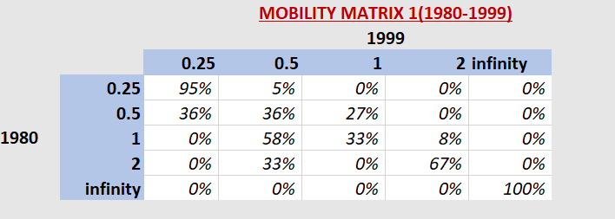
Mobility Matrix(1980-1999)
Economic liberalization: Countries like India (1991 reforms) and China (1978 reforms continuing into the 1980s and 1990s) opened up their economies to trade, foreign investments, and market competition
Many middle-income countries advanced due to industrialization and adoption of new technologies, enabling productivity gains. Example: Korea transitioned into advanced industries like electronics and automotiv.
Debt Crisis: Many Latin American countries (e.g., Argentina, Brazil, and Mexico) faced massive debt defaults in the 1980s, leading to economic stagnation or regressions.
The 1997 Asian Financial Crisis impacted countries like Thailand, Indonesia, and Malaysia, leading to recessions and slowed growth
There is a significant upward mobility from the lower income groups to the higher income groups.
The middle income groups (0.5 and 1) experienced the most movement, with a significant proportion moving both up and down the income ladder.
The highest income group (infinity) remained relatively stable, with only a small proportion moving out.

Slide 12
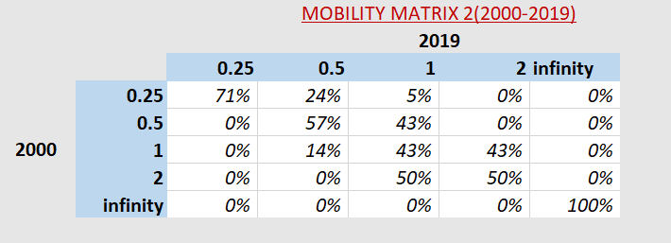
Mobility Matrix(2000-2019)
Global Financial Crisis (2008–2009)
High-income and middle-income countries were severely affected:
Europe: Countries like Greece, Spain, and Italy experienced recessions and slow recoveries due to debt crises and austerity measures.
United States: Despite recovery, the crisis highlighted stagnating incomes and inequality.
India: Growth was fueled by the IT sector, urbanization, and economic reforms. Increased domestic consumption also played a major role.
Botswana, Angola, Nigeria, and Chile, experienced significant growth during the early 2000s due to high global demand for commodities (oil, metals, and agricultural products).
There is a significant upward mobility from the lower income groups to the higher income groups, especially from the 0.5 and 1 income groups.
The middle income groups (0.5 and 1) experienced the most movement, with a significant proportion moving both up and down the income ladder.
The highest income group (infinity) remained relatively stable, with only a small proportion moving out.

Slide 13
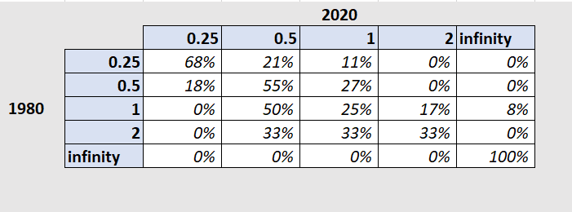
Mobility Matrix(1980-2019)
Low-Income Group (1980:0.25)
Majority stayed low-income (68%), but 18% moved up to lower-middle income(0.5)
Countries like Bangladesh and Nepal likely advanced, while others like Uganda and Congo, Dem. Rep. remained low-income.
Lower-Middle Income Group (1980: 0.5)
5% stayed stable, while 27% moved up to middle-income (1).
A small fraction regressed to low income (0.25).
Countries like India and Indonesia likely progressed, whereas others like Philippines stayed the same.
High-Income Group (1980: infinity).
All countries retained their high-income status, showing entrenched wealth disparities.
Middle-Income Group (1980: 1)
50% remained middle-income, while 42% moved up (to 2 or infinity).
Eastern Europe (e.g., Poland) and some Asian countries (e.g., Malaysia) likely advanced.Latin America (e.g., Brazil, Argentina) mostly stagnated.
Upper-Middle Income Group (1980: 2)
Divided evenly: 33% moved up to high income (infinity), 33% stayed stable, and 33% fell to middle-income (1).
Korea (Rep.) and Israel likely progressed, while some European countries like Spain remained stable.

Slide 14
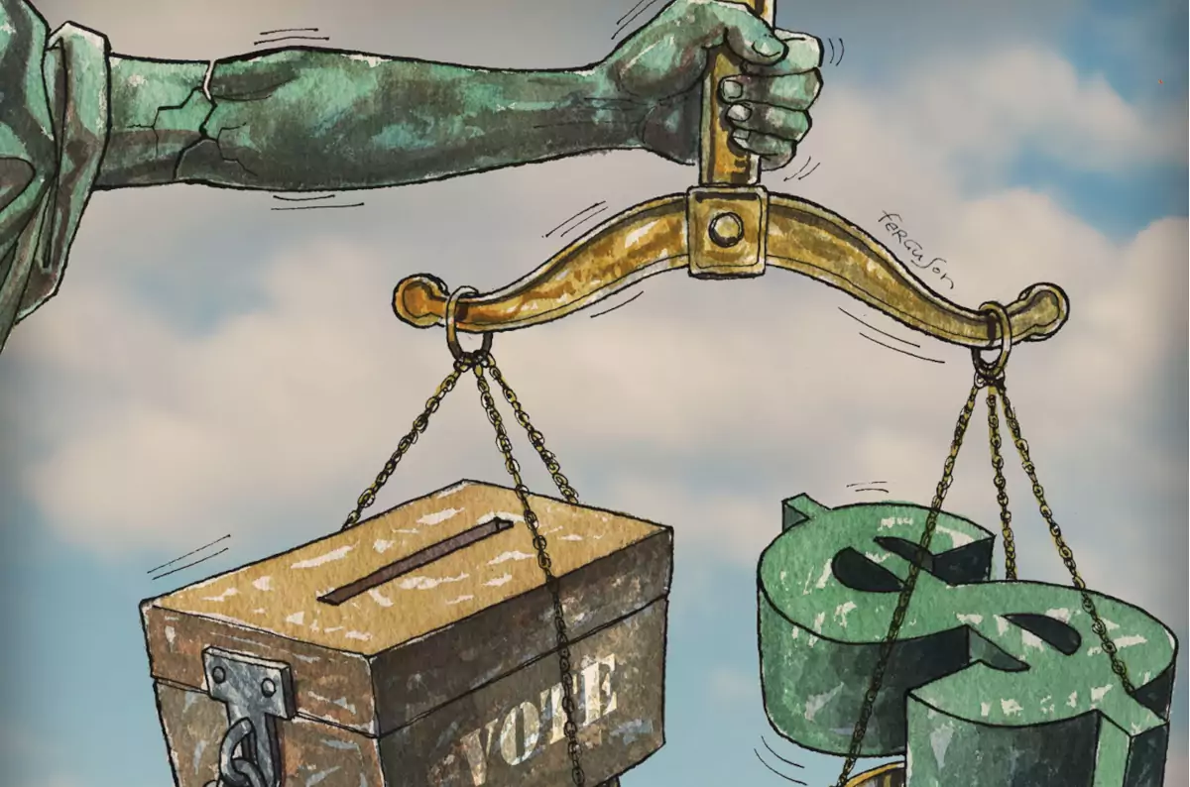
Understanding variations in growth rates across income distribution Growth Incidence Curves (GIC)

Slide 19
Before 2000, the growth rates for each centile of income distribution indicates a “pro-poor” trend
Latin American countries suffered from debt crises, the Middle East suffered from wars and oil price volatility, Japan experienced prolonged economic stagnation, while other parts of the world were still recovering from the impact of the Cold War, developing countries like China, Vietnam and India made huge strides
Growth stories triggered an economic boost to those lying towards the lower centiles of the global income distribution
The “pro-poor” trend was somewhat dampened after 2000
Emergence of the “global middle class”; notable events: the 2008 financial crisis, crisis in the Eurozone
With the rise of the Big Tech, this period also witnessed a rise in inequality

Slide 20
The overall (1980-2019) GIC indicates that the growth has been largely “pro-poor”, predominantly dictated by the dynamic shifts in the global income patterns (along with the emergence of the “global middle class” and unprecedented economic events) observed till the early 2000s

Slide 21

Growth Inequality POVERTY
Conundrum using Regression Analysis

Slide 22
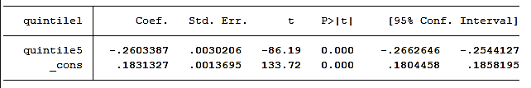

Income shares of the bottom decile and quintile in our sample are negatively-related to that of the top quintile
Even when an economy prospers, the benefits of this prosperity are mostly reaped by the richest few while the poorest get an increasingly lesser share of the pie
The picture depicted by our sample is that of a zero-sum game, i.e., the rich get richer only at the cost of the poor getting poorer
***
***
Larger gaps (>5 years) : Coefficients are smaller in absolute values
Growth in the shorter run is more directly linked to inequality (since it inevitably calls for an increased concentration of wealth in the hands of the elites), while in the longer run this relationship weakens as the effect of the growth eventually trickles down
***
***
Observations are from more than 70 countries, over 1980-2019
All data are sourced from World Bank
‘*’- significance at 10% level, ‘**’- significance at 5% level, ‘***’- significance at 1% level

Slide 23
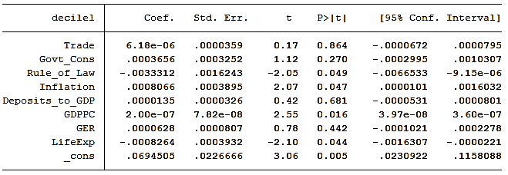
The coefficient of GDP per capita tis statistically significant and positive
Ignoring the inequality aspect for the time being, we find that the poor in countries with higher average income do enjoy a relatively larger share of the pie compared to those in countries with smaller average income
The coefficient of inflation is also statistically significant and positive
**
**
**
**
***
Countries with higher GDP per capita often enjoy healthy amounts of inflation; Unstable economies suffering from highly volatile inflation rates, with little or no growth, the population being largely poor
The coefficient of rule of law is statistically significant and negative, hinting at the rising inequality in extremely prosperous and liberal democracies with a strong rule of law
Effectiveness of government’s participation in welfare programs vis-à-vis the state of law and order in the country
The coefficient of life expectancy is statistically significant (though not always) and negative, again hinting at the rising inequality in advanced economies making rapid strides in health
A large proportion of poor being engaged in the agricultural sector, we ran a simple regression and found the coefficient of per worker agricultural value added to be almost statistically significant
Here, we focus on the cross-section of 2018
The coefficient, however, turned out to be insignificant in an MLRM due to possible multicollinearity with GDP per capita

Slide 24
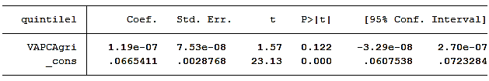
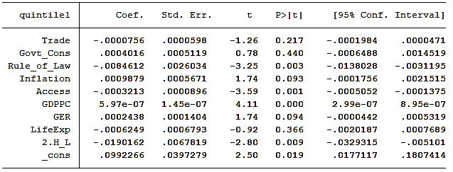
***
The coefficient for the high-income group to be statistically significantly negative than the low-income group
Despite it being well-established, that the poor in countries with higher income may be better-off than the poor in countries with lower income, it cannot be ignored that the poor in the high-income countries experience the brunt of inequality more severely than those elsewhere
***
*
***
***
*
***
**

